Slide 1
Introduction to Research and Research Methodologies
Session 01
Hidayaturrahman, S.Kom., M.T.

Slide 2
Learning Outcome
LO1: Understand the fundamentals of scientific research and the research lifecycle.
LO2: Analyze and critically evaluate research topics, literature, and theoretical frameworks.
LO3: Design and apply appropriate research methods to generate valid and reproducible results.
LO4: Compose and present research findings in formats suitable for high-impact journals and conferences.

Slide 3
Outline
Definition of research and its role in computer science.
Types of research: Basic vs. applied, qualitative, quantitative, mixed methods.
The research lifecycle: Idea generation, hypothesis formulation, study design, implementation, and dissemination.
Importance of originality and contribution in research.

Slide 4
Definition of research and its role in computer science

Slide 5
Definition of research and its role in computer science
Research is a systematic process of inquiry aimed at discovering, interpreting, and applying new knowledge. In computer science, research addresses questions ranging from theoretical advancements to practical applications.

Slide 6
Definition of research and its role in computer science
What is Research?
  Research involves systematic investigation to establish facts, solve problems, and develop new knowledge.
  Types of Research Outputs:
    Papers, patents, algorithms, software tools, frameworks, etc.
Why Conduct Research?
  To address gaps in knowledge.
  To propose innovative solutions to existing problems.
  To contribute to societal, technological, and economic advancements.

Slide 7
Definition of research and its role in computer science
Applications in Computer Science
  Artificial Intelligence and Machine Learning
  Cybersecurity
  Human-Computer Interaction
  Software Engineering

Slide 8
Types of research

Slide 9
Types of research
Basic vs. Applied Research
Basic Research:
  Explores fundamental principles.
  Example: Studying the theoretical limits of computation.
Applied Research:
  Focuses on practical problem-solving.
  Example: Developing an efficient search engine algorithm.

Slide 10
Types of research
Qualitative, Quantitative, and Mixed-Methods Research
Qualitative:
  Focuses on descriptive, non-numeric data.
  Example: User experience studies.
Quantitative:
  Involves measurable, numeric data.
  Example: Analyzing algorithm efficiency.
Mixed-Methods:
  Combines both qualitative and quantitative approaches.
  Example: A study integrating survey results and system performance data.

Slide 11
The research lifecycle

Slide 12
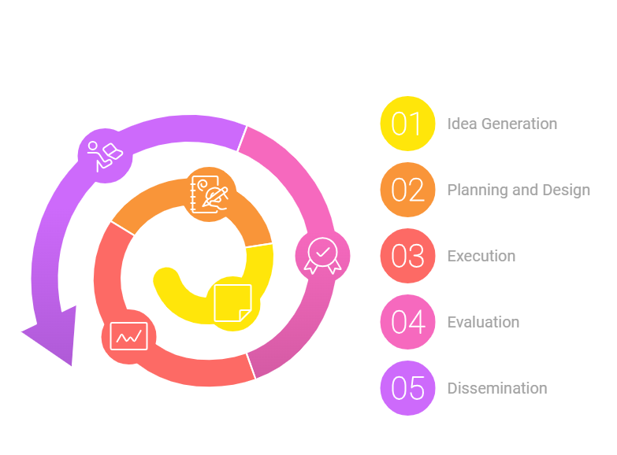
The research lifecycle

Slide 13
The research lifecycle
Idea Generation:
  Brainstorming and identifying gaps in knowledge.
  Tools: Literature databases (Google Scholar, IEEE Xplore).
Planning and Design:
  Defining objectives, hypotheses, and methodologies.
  Example: Formulating research questions like "How can deep learning improve medical imaging accuracy?"
Execution:
  Data collection, analysis, and experimentation.
  Tools: Python, R, TensorFlow, MATLAB.
Evaluation:
  Assessing results against objectives.
  Metrics: Accuracy, runtime, scalability.
Dissemination:
  Publishing papers and presenting findings.
  Venues: Journals, conferences, workshops.

Slide 14
Importance of originality and contribution in research

Slide 15
Importance of originality and contribution in research
Avoid duplication of existing work by:
  Conducting comprehensive literature reviews.
  Leveraging originality check tools (e.g., Turnitin).
Focus on:
  Novel algorithms or frameworks.
  New applications of existing methodologies.

Slide 16
Common Challenges in Research

Slide 17
Common Challenges in Research
Identifying impactful research problems.
Managing time effectively.
Maintaining research ethics and integrity.
Communicating findings clearly.

Slide 18
Summary
Research in computer science is both foundational and applied, spanning diverse topics.
The research lifecycle ensures structured inquiry and reliable outcomes.
Understanding types of research and their applications is key to successful research endeavors.

Slide 19
Activity
Discussion:
  Reflect on a problem you have encountered in computer science.
  Discuss whether it fits basic or applied research.
Group Work:
  Identify three recent research papers from reputable journals.
  Classify their research type (qualitative, quantitative, or mixed-methods).

Slide 20
References

Slide 21
References
Creswell, J. W., & Creswell, J. D. (2017). Research Design: Qualitative, Quantitative, and Mixed Methods Approaches. SAGE Publications.
Mack, C. A. (2018). How to Write a Good Scientific Paper. SPIE.
Google Scholar: https://scholar.google.com
IEEE Xplore: https://ieeexplore.ieee.org

